Slide 1
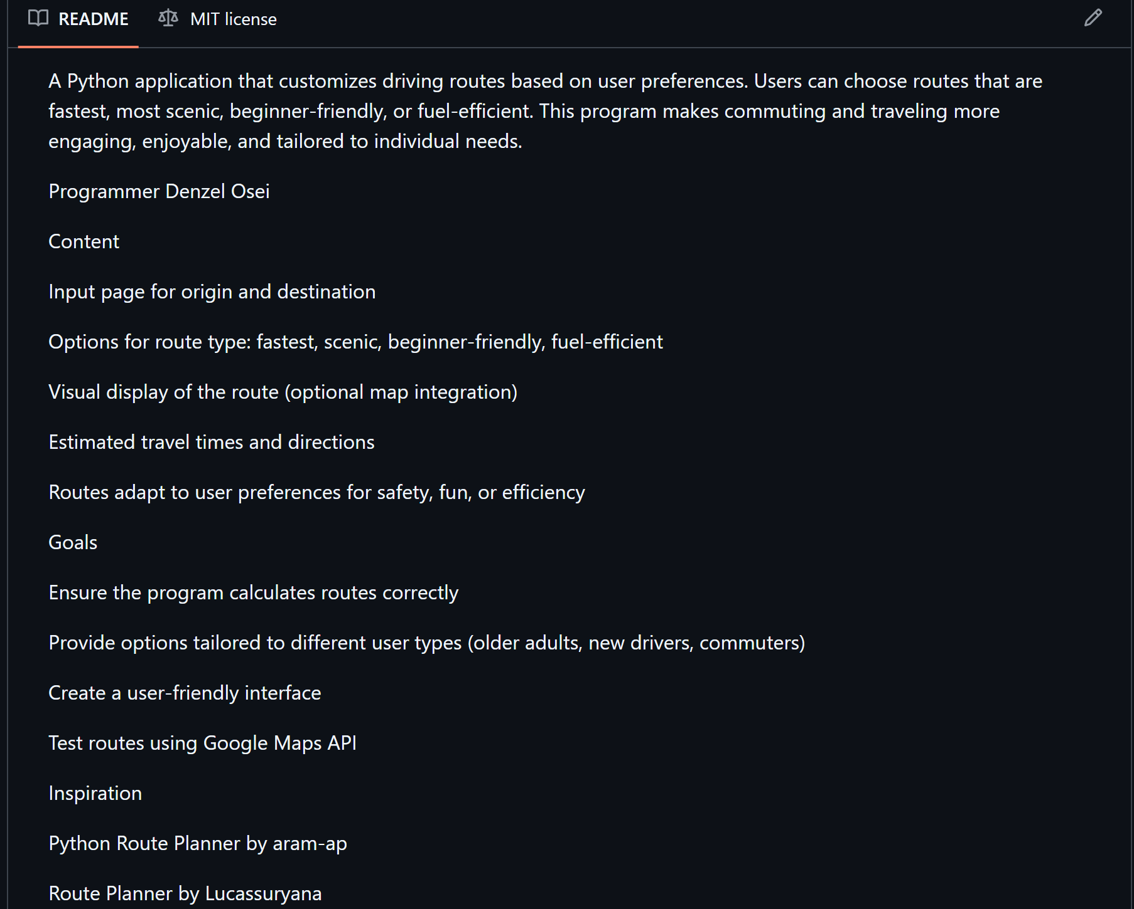
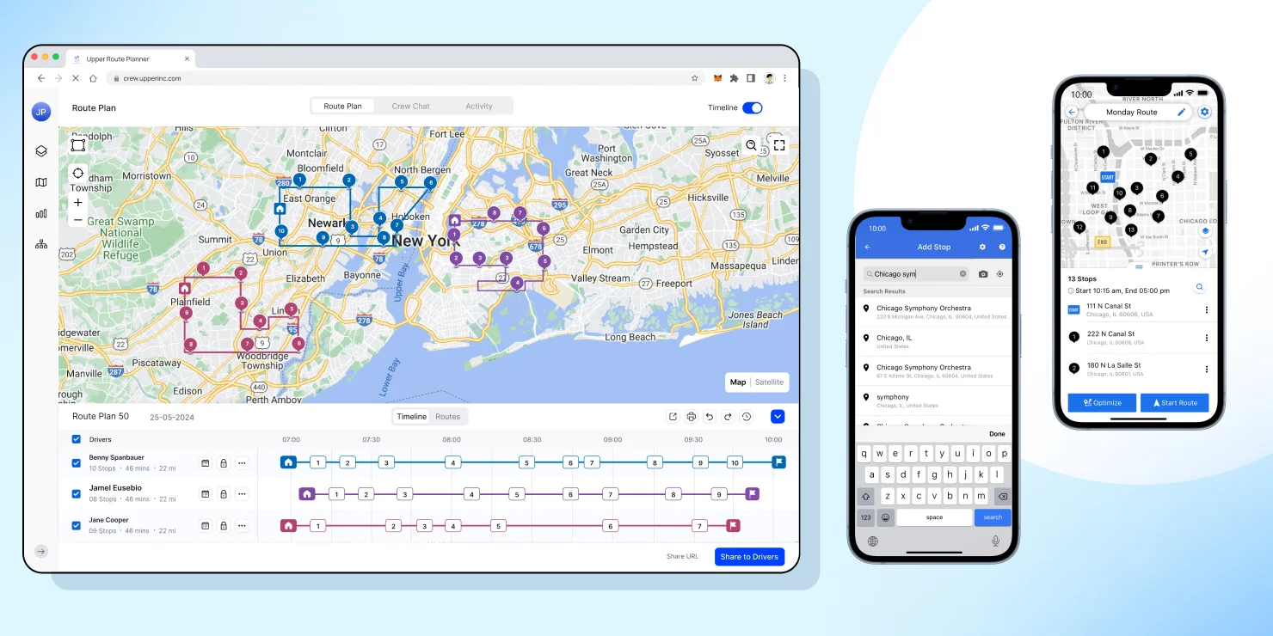
Opti-Route
“The Smartest Route for the Way YOU Want to Drive”
About the Project:
Opti-Route helps people pick the best route for their driving style. Whether someone wants the fastest way, the safest roads, or a more relaxed drive, OptiRoute adjusts the path to match what they prefer. It makes everyday driving easier, more personal, and less stressful.
Current Progress:
Set up the project foundation: Chose and submitted my project topic (Exercise 6), added it to the Teams spreadsheet, and joined the KSU-IS GitHub organization.
Created and organized my repo: Made the Opti-Route GitHub repository, added a README, committed changes, and added the MIT license.
Early research & inspiration: Found and reviewed a couple route-planning Python projects to guide my own approach.
Next Steps:
Finish updating the project roadmap with notes from the reference code and outline clear tasks for Sprint 2.
Begin Sprint 2 development, including input handling, route-type options, and early algorithm logic.
Elaborate on what you want to discuss.

